Slide 1
Selecting an Affordable School – Information to Help Families and Students Make an Informed Financial Decision
Copyright ® 2018 Finance Authority of Maine

Slide 2
Today’s Presentation
The goal of today’s session is to provide information, resources, and tools to help you support your families.
Sharing information related to these three steps will help students and families make more informed decisions:
Step One: Get Financially Prepared
Step Two: Build a List of Schools
Step Three: Compare and Understand the Options

Slide 3
Step One:
Get Prepared Financially

Slide 4
Get Prepared Financially
The college decision making process starts early!
Those families who are unprepared and don’t know what to expect when paying for college will have fewer good options.
We’ll start by focusing on two areas that can help families have more options:
College savings
General financial wellness

Slide 5
The Importance of Saving for College
Saving for college is absolutely critical!
Lower income families:
Students with the highest level of need typically have an unpaid balance even after financial aid.
The only schools in Maine that meet full need are Bates, Bowdoin, and Colby.
Middle income families:
Students from these families have Expected Family Contributions (EFC) that are higher than anticipated.
Let’s look at EFCs for middle income families.
Notes:
Let’s look at some EFCs for middle to upper income families.

Slide 6
The Importance of Saving for College
In the following scenarios, none of the families have savings.
Income Assets/Savings | Family A $40,000 $0 | Family B $50,000 $0 | Family C $60,000 $0 | Family D $70,000 $0
Expected Contribution from Income | 343 | 2,111 | 3,710 | 5,736
Expected Contribution from Assets/Savings | 0 | 0 | 0 | 0
Total Expected Parent Contribution | 343 | 2,111 | 3,710 | 5,736
Notes:
Assumptions:
Family of four (two parents and two children)
Oldest parent age 46
Both parents working outside the home
Used federal tax rate of 2% for $40,000; 3% for 50,000; 5% for $60,000; 6% for 70,000
* For the purposes of the FAFSA, many assets are excluded including the value of the primary residence, retirement funds, and small family owned businesses.

Slide 7
The Importance of Saving for College
What might an award look like at a typical University of Maine System school?
If Pell eligible, tuition and fees covered at UMFK, UMA, UMPI, and UMM with grants and scholarships.
However, often the only aid available to cover room and board is a $5,500 Federal Direct Loan.
None of the UMS schools meet full need.
Even 0 EFC students typically have a “gap” which can be several thousand dollars and for those with an EFC above 0, the amount to be covered is the gap plus the EFC.
Notes:
5486 is pell cutoff
Some students may be eligible for merit aid

Slide 8
The Importance of Saving for College
How will students and families pay the bill?
What if the parents had savings?
Notes:
Some students may be eligible for merit aid
How will these families pay the bill?

Slide 9
The Importance of Saving for College
Income Assets/Savings | Family A $60,000 $0 | Family B $60,000 $10,000 | Family C $60,000 $15,000 | Family D $60,000 $20,000
Expected contribution from income | 3,710 | 3,710 | 3,710 | 3,710
Expected contribution from assets | 0 | 0 | 107 | 257
Total Expected Parent Contribution | 3,710 | 3,710 | 3,817 | 3,967
Notes:
Parent EFC is made up of two parts – contribution from income and contribution from assets
Savings will give families options
Little to no impact on the EFC, even if attending higher cost schools, but so many more options!

Slide 10
The Importance of Saving for College
Families earning under $50,000 typically do not even have to provide savings and assets on the FAFSA.
Having savings gives a family options.
Notes:
$12 savings per week - $624 per year plus $300 NS grant = $924
$924 over 10 years is $9240 without any earnings
Start earlier or contribute a bit more, savings will be even more substantial (others contributing)

Slide 11
Many Ways to Save!
Common Savings Vehicles
529s
Coverdell Education Savings Accounts
Savings Bonds
Roth IRA
Taxable Savings and Investment Accounts
Uniform Gift to Minors Act (UGMA)/Uniform Transfers to Minors Act (UTMA)
Best if savings is in the parent’s name, not the student’s or another family member’s.
For information on possible federal income tax benefits for the various vehicles, visit irs.gov/forms-pubs/about-publication-970
Please consult your investment and/or tax advisor for guidance.

Slide 12
General Financial Wellness
What can families do to have more options?
Pay off other debt and reduce financial obligations.
Free up money in the family budget so that a portion of the bill can be paid through a tuition payment plan.
These plans allow families to pay over time.
Payment plans aren’t loans. No interest charged, just a small enrollment fee.
Notes:
We sometimes hear that people will make the big purchase so that their savings will be reduced and not impact financial aid eligibility. As must demonstrated, savings has very little impact on EFC so this is a really bad idea. If big purchase are paid for out of family budget, impacts ability to participate in payment plan.
Note from Nikki: I can’t remember where I heard this (and I couldn’t find online) – there is an average amount of money that a family doesn’t have in expenses when a child goes away to college (families are no longer paying for food, gas, hot water, etc.) That money is freed up for a payment plan. Worth mentioning?

Slide 13
General Financial Wellness
Another benefit of saving for college….
Parents who have been making contributions to a college savings fund are already accustomed to living on less.
Once student enrolls, those regular saving contributions can be diverted to tuition plan payments.

Slide 14
General Financial Wellness
One way to maintain financial wellness is for parents and students to discuss the plan to pay for college.
Ideally, the conversation should start prior to senior year.
Laying the groundwork and establishing expectations will make it easier once the award letters start arriving.
Notes:
Share Mary’s analogy – like when on a plane, they tell you to put the oxygen mask on yourself first, then your child. Parents need to protract their financial well being too – and not deplete retirement accounts or borrow ridiculous amounts.

Slide 15
General Financial Wellness
A recent Citizens Bank survey found:
73% of millennials with student loan debt say that they inherited their attitudes toward financial responsibility from their parents.
61% believe that their parents do not have a full grasp on what paying for college is like today.
53% believe that discussing paying for college with their parents earlier would have decreased the amount of student loan debt they incurred.
Notes:
Share Mary’s analogy – like when on a plane, they tell you to put the oxygen mask on yourself first, then your child. Parents need to protract their financial well being too – and not deplete retirement accounts or borrow ridiculous amounts.

Slide 16
General Financial Wellness
Paying for college is a piecemeal approach.
Increasing the number of “pieces” available will result in an increased number of options.
More pieces are needed than ever before!
Other pieces beyond financial aid, savings, and payment plans include merit aid, student income, student savings, and scholarships.
Notes:
Those reliant on only once source, whether it be financial aid, savings, loans, etc. will have fewer options.
I don't know if this is the place, but what about the point that students really can't be expected to pay for school themselves anymore- costs have been rising and it's not possible to earn in a summer/school year enough to cover the gap between financial aid and the cost
Other available pieces beyond financial aid, savings, and payment plans include merit aid, student income, and student savings.

Slide 17
Step Two:
Build a List of Schools

Slide 18
Researching Schools
It is important to research schools from a financial aid perspective.
Schools vary dramatically in terms of the types of aid offered and their ability to meet full need.
The focus should be on Net Price – not sticker price.
The Net Price is the amount a student pays for a single year AFTER subtracting grants and scholarships.

Slide 19
Researching Schools
What matters is how much a school is going to cost that individual student.
Get started by researching “percent of need met” to find schools that traditionally have good financial aid awards.
Where can “percent of need met” be found?
Notes:
Expensive schools should not be ruled out as sometimes those schools have better financial aid and are more affordable.

Slide 20
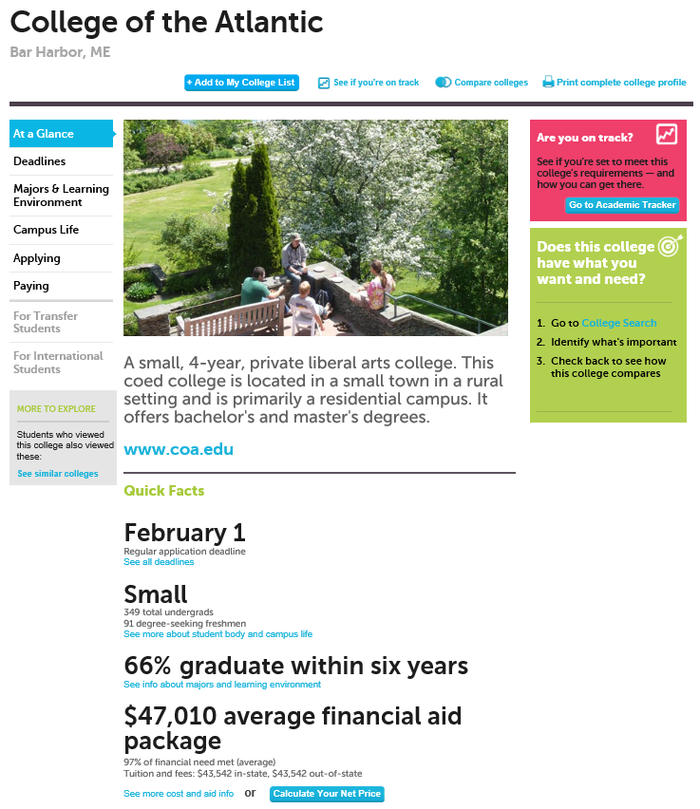
Bigfuture.collegeboard.org
Schools can be looked up individually.
On the “At a Glance” page, you can find % of need met.

Slide 21
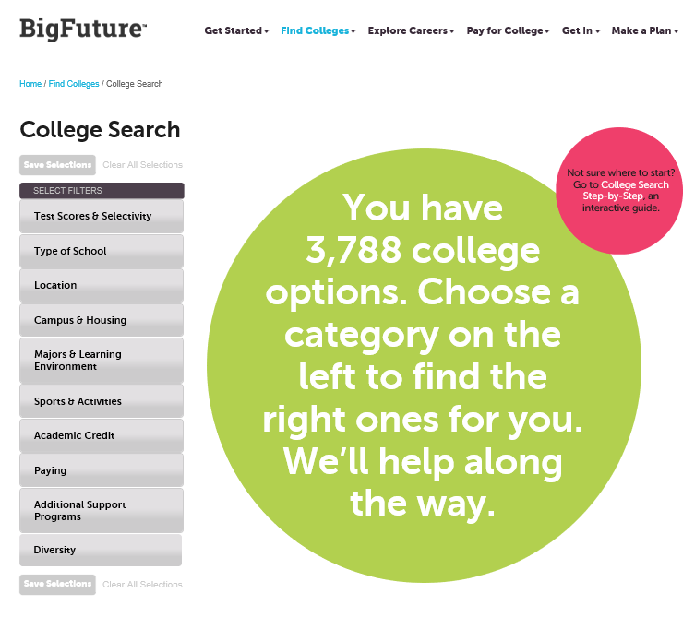
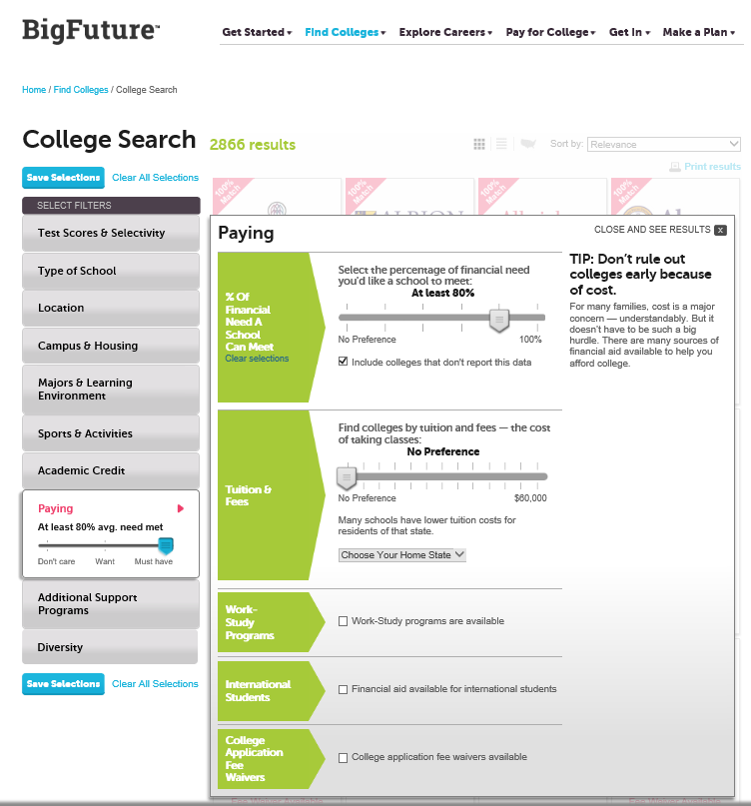
Bigfuture.collegeboard.org
Notes:
It is possible to search for school based on this criteria (or in conjunction with other criteria).

Slide 22
Research Net Price
Next, research schools using each school’s Net Price Calculator (NPC).
Schools are required to have a NPC on their website (usually in the financial aid section).
NPCs use school specific data to provide estimated net price based on a student’s individual circumstances.
Up next, NPC results for two schools using exact same information ($67,000 – 5,012 EFC)

Slide 23
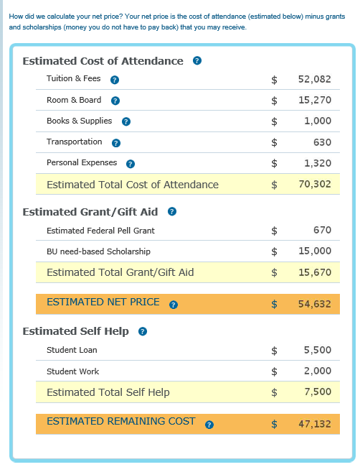
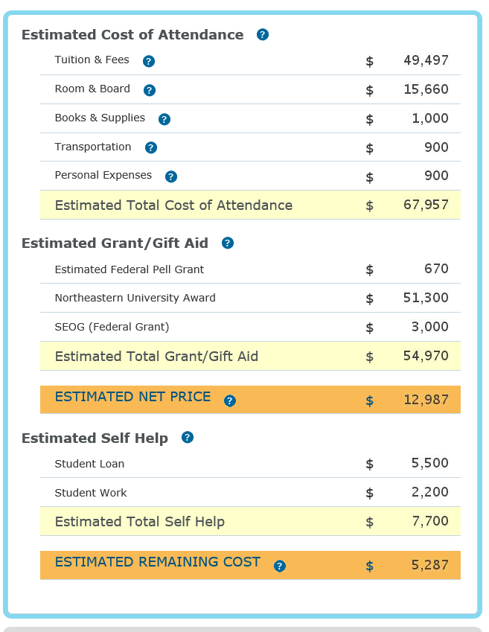
Research Net Price
Boston University
Northeastern University
Notes:
BU asked about merit items and NU did not

Slide 24
Research Net Price
Don’t make decision based on NPC – it is just an estimate!
Merit aid may impact the end result at some schools.
Many of the most prestigious schools don’t offer merit aid.
“Second” tier schools are often a good sources of merit aid – worth considering for good students with limited financial need (as defined by the school).
If the estimated award isn’t great, the student may want to consider adding additional schools to the list.
Notes:
Examples of second tier schools include:

Slide 25
Build the List
It is recommend that student apply to multiple schools (four to eight?).
Students should try very hard not to get their heart set on one specific school early in the process.
Important to have a financial aid “safety school” on the list.
Notes:
2-2-2 approach

Slide 26
Step Three:
Compare and Understand the Options

Slide 27
Comparing Financial Aid Awards
Students need to do an “apples to apples” comparison of award offers.
Focus, first on the direct costs after grants and scholarships.
This will provide the direct cost “net price” which then can be compared across schools.
Next, if borrowing is needed, subtract Federal Direct Loans.

Slide 28
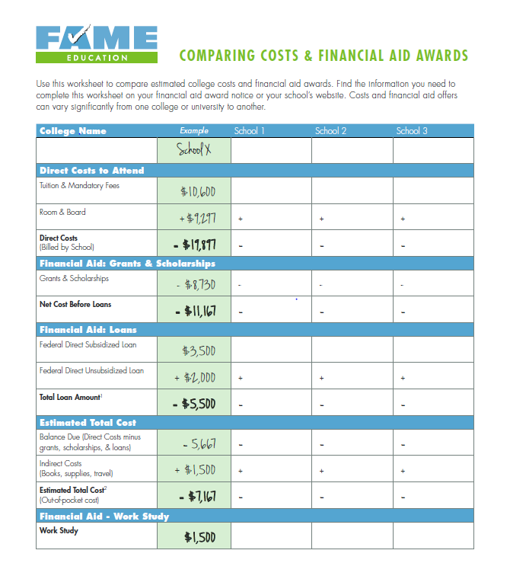
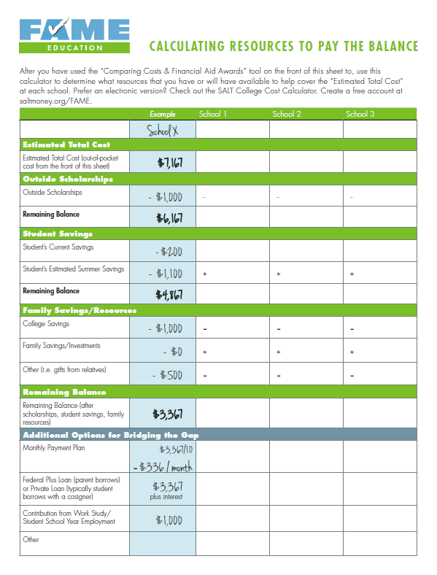
Tools To Help!
Notes:
Front of form helps with what we cover on previous slide.
Back focuses on how to remaining balance and covers some of those “pieces” we talked about earlier (scholarships, savings, payment plans, etc.)

Slide 29
Consider the ROI
Consider the Return on Investment (ROI) – especially if borrowing is needed.
What are the future job openings in the student’s desired field?
What are the potential earnings and benefits?
Great place to research this information is Career One Stop: careeronestop.org

Slide 30
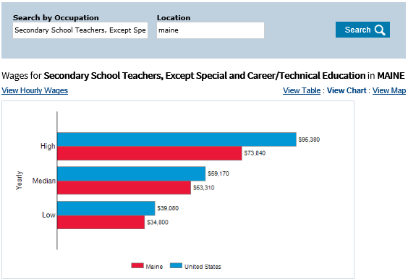
Research Salary

Slide 31
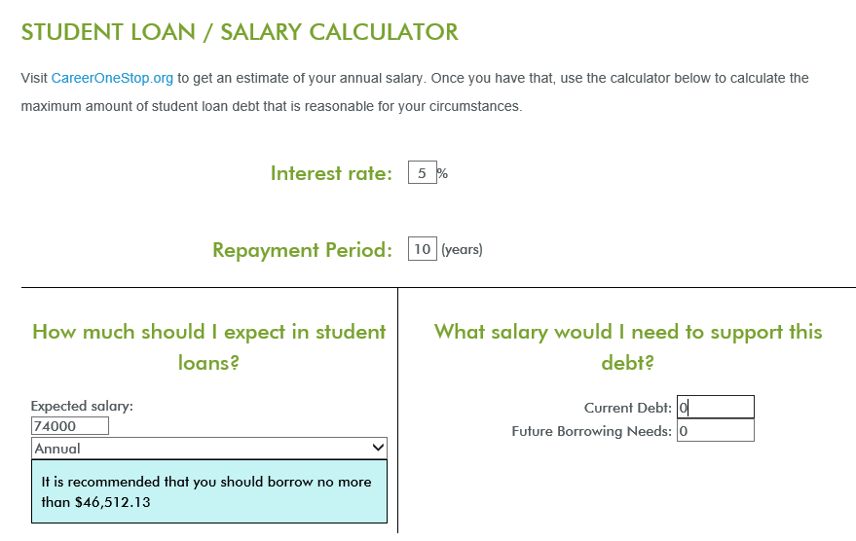
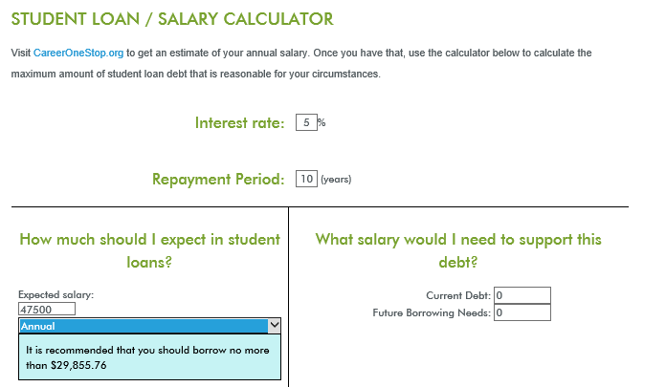
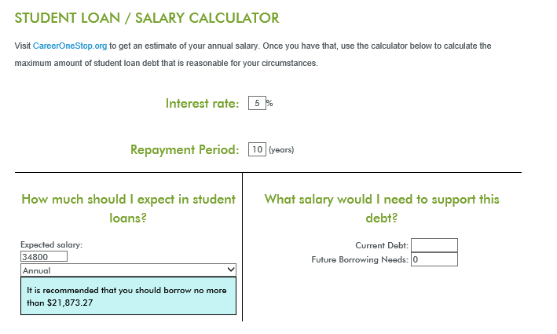
Use FAME’s Student Loan/ Salary Calculator
FAMEmaine.com – Quick Tips – Calculator & Tools
Notes:
Show where it can be found

Slide 32
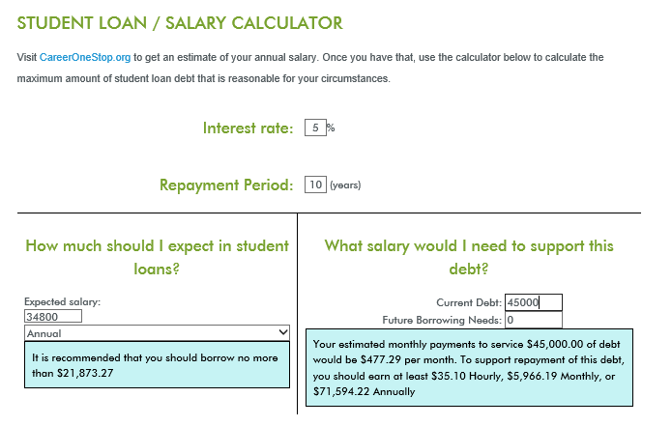
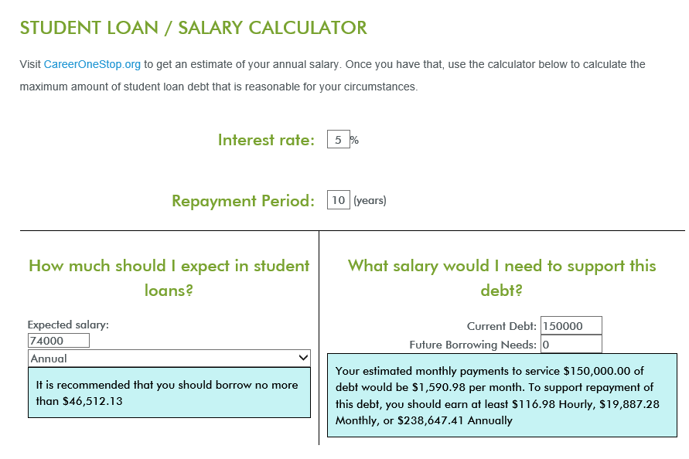
Use FAME’s Student Loan/ Salary Calculator
We want students to avoid this disconnect!
Notes:
But what about if the student has to borrow another $5000 per year?
Need to make a financially smart decision about college selection. Also, saving would have helped keep borrowing down.

Slide 33
Make Borrowing More Relatable
On the surface, borrowing $25,000 vs $45,000 may not see like that big of a difference, especially if done in $5,000 increments.
However, knowing that to support that debt an income of $39,700 vs $71,500 is needed may mean more.
Or, share the rule of thumb that each $10,000 borrowed equates to a little more than $100 per month payment (at 5% interest rate). That is a monthly payment of $265 vs $477.

Slide 34
Smart Borrowing
If loans are necessary beyond Federal Direct Student Loans, encourage students/families to visit TheLoanforME.com
This site will help them compare loan options and make informed decisions.
For most students and parents, private loans are now more affordable than PLUS Loans (though approval criteria is stricter).

Slide 35
Messages and Activities
As early as possible and Freshmen year:
Importance of saving – share NextGen materials
Talk about the future – goals and expectations
Concept of paying for college as a “piecemeal approach”
Sophomore and Junior years:
Big Future (bigfuture.collegeboard.org)
College Search
EFC Calculator
Net Price Calculator
Notes:
Parents are not letting their students down if they decide some schools are simply not affordable or a good long term decision (this thought is only attributable to Mila and others may not agree!).

Slide 36
Messages and Activities
Senior Year:
FAFSA/Financial Aid Process Completion
Comparing Financial Aid Awards
Student Loan/Salary Calculator (with salary research from CareerOneStop)
FAME Resources:
Calculators & Tools - FAMEmaine.com/education/quick-links/calculators-tools/
Filing the FAFSA - FAMEmaine.com/FAFSA
Informational Videos - FAMEmaine.com/education/quick-links/informational-videos/
TheLoanforME - TheLoanforME.com
Notes:
Parents are not letting their students down if they decide some schools are simply not affordable or a good long term decision (this thought is only attributable to Mila and others may not agree!).

Slide 37
Closing Thoughts
Encourage students and families to create scenarios where they have as many options as possible.
For most students, there are multiple pathways and schools where they can achieve their goals.
Living on the “cheap” and making financial sacrifices while in school will help students have more options after school – stay focused on the long term.
Notes:
Parents are not letting their students down if they decide some schools are simply not affordable or a good long term decision (this thought is only attributable to Mila and others may not agree!).

Slide 38
Thank You!
Finance Authority of Maine
5 Community Drive
P.O. Box 949
Augusta, ME 04332
1-800-228-3734
TTY: 207-626-2717
education@FAMEmaine.com
FAMEmaine.com

